Slide 1
Flow control statments

Slide 2
Python if Statement
An if statement executes a block of code only when the specified condition is met.
Syntax
if condition:
# body of statements
If condition evaluates to True, the body of the if statement is executed.
If condition evaluates to False, the body of the if statement will be skipped from execution.
.

Slide 3
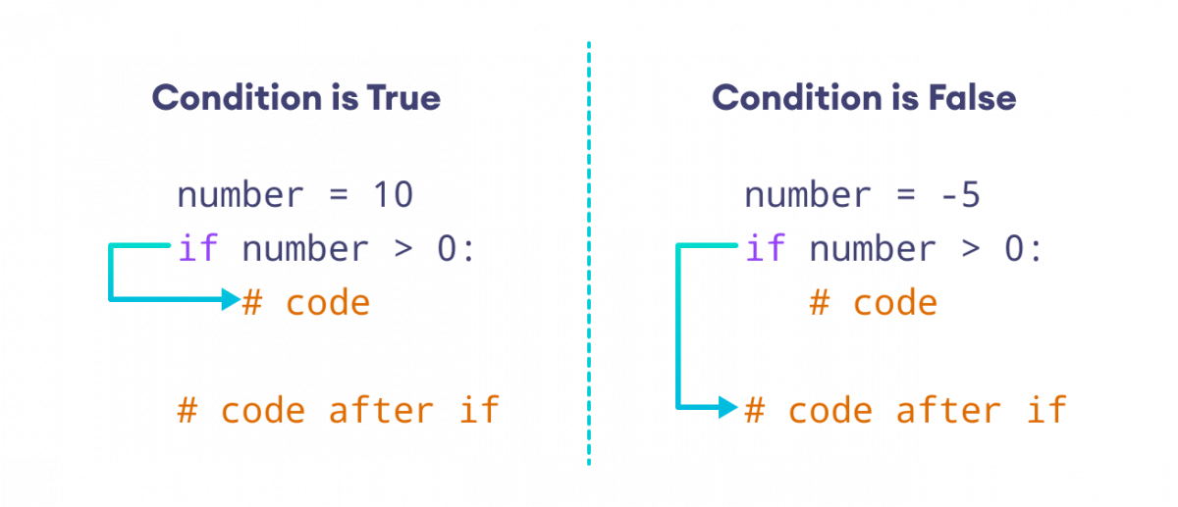
Example

Slide 4
Indentation in Python
Python uses indentation to define a block of code, such as the body of an if statement.
We usually use four spaces for indentation in Python, although any number of spaces works as long as we are consistent.

Slide 5
Python if else Statement
An if statement can have an optional else clause. Then else statement executes if the condition in the if statement evalutes to False
Syntax:
if condition:
#body of statement
else
#body of statement

Slide 6
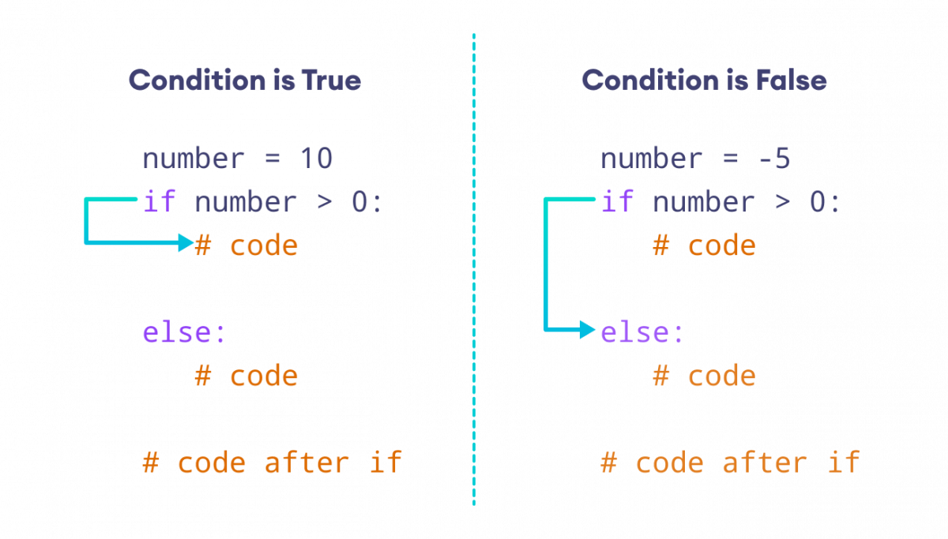
Working Example

Slide 7
Python if…elif…else Statement
Syntax:
if condition1:
# code block 1
elif condition 2:
# code block 2
else
# code block 3

Slide 8
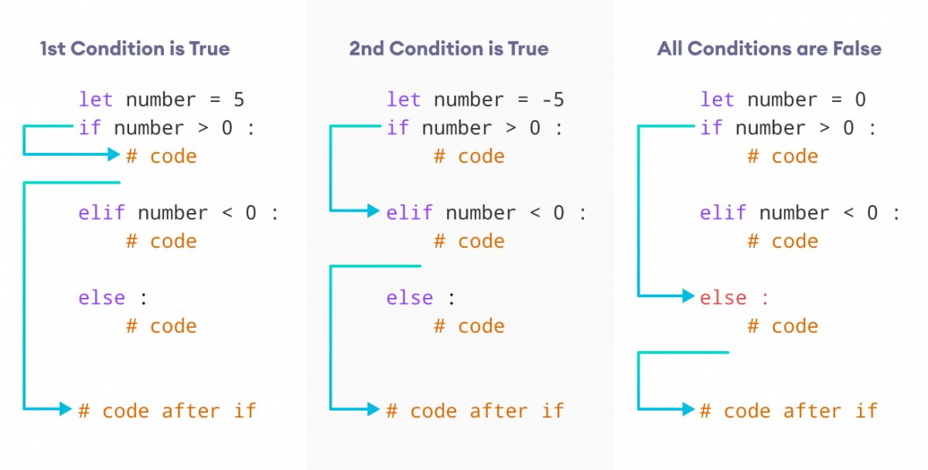

Slide 9
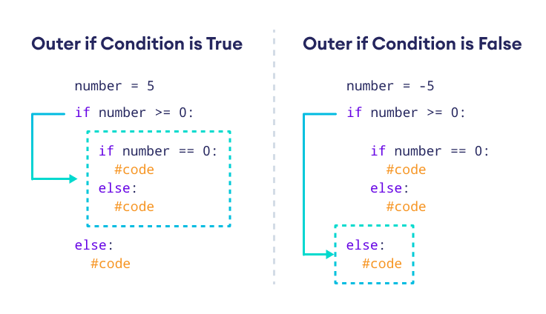
Python Nested if Statements

Slide 10
NOTE:
Ternary Operator in Python if …else
Python doesn’t have a Ternary operator. How ever we can use if..else to work like a ternary operator
Eg:
Grade=40
Result= ‘pass’ if grade >=40 else ‘fail’
Print(result)

Slide 11
For loop
Syntax:
for val in sequence:
# body of the loop
Note: We use a for loop to iterate over sequences such as lists, strings, dictionaries etc
We use indentation in for loop also

Slide 12
For loop with range
range() function generates a sequence of characters
Sytax:
range(start,stop,step)
Range() function returns an immutable sequence of numbers
Note:
For loop with else

Slide 13
Python while loop
While loop syntax
while condition:
# body of while loop
Note:
1. while loop evaluates the condition, which is Boolean expression.
if the condition is true,body of while loop is executed. the condition is evaluated again
This process continues until the condition is false
Once the condition evaluates to false,the loop terminates

Slide 14
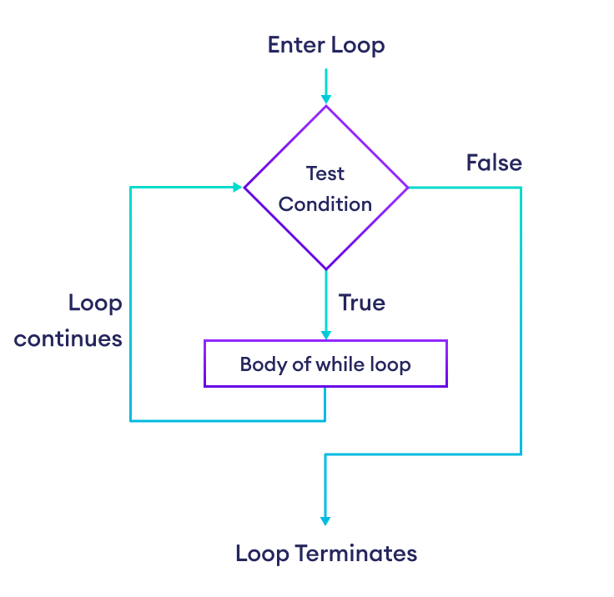

Slide 15
Infinite while loop
if the condition of a while loop always evaluates to true, the loop runs continuously
While with break
While with else

